Slide 1
NZATD
PROVING THE VALUE IN TRAINING

Slide 2
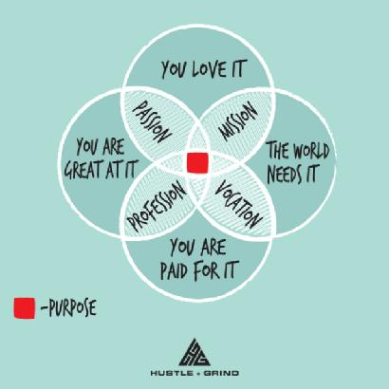
This is you

Slide 3
Point of Difference
What is your point of difference?
How do you stand out? How are you different and how do you do training differently that will give you your new training gig or keep your company having a strategic advantage over competitors in the marketplace.
What is your strategic advantage?

Slide 4
PURPLE COW

Slide 5
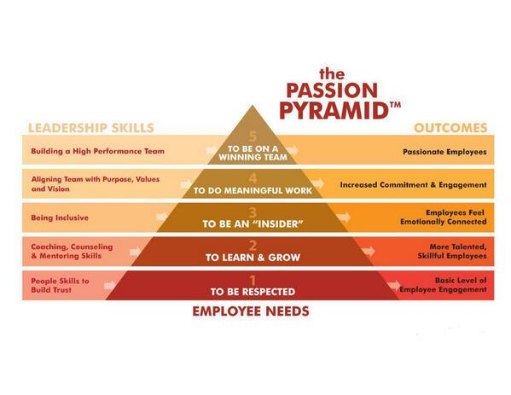
The Passion Pyramid

Slide 6
The Passion Pyramid
Every leader knows their team members who are truly passionate about their work and the organization they work for.
These employees are focused, committed, and will go to extreme lengths to fulfill their responsibilities every day. If only all team members were like that! Well they can be. People don’t become passionate for no reason.
They become passionate about doing things that are both emotionally satisfying and that they see as significant, worthwhile or meaningful. In other words, there are some basic human needs that when satisfied can bring out the passion in any individual.
The Passion Pyramid identifies five human needs that ignite passion, the leadership skills needed to create the conditions to satisfy each need, and then describes the outcome or payoff to the organization for satisfying the need. The Passion Pyramid is the foundation for the Employee Passion Survey, so an understanding of the five levels will help with the interpretation of the report.

Slide 7
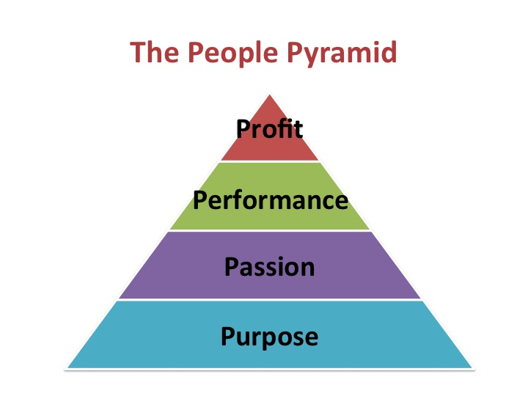
The People Pyramid

Slide 8
The D Words
If your staff are not engaged and passionate and committed to you then they are dysfunctional, disempowered, depressed, demotivated, disengaged and are absent from work costing the company lots of money.
If staff are disengaged and don’t believe that they are heard and the training does not inspire or motivate them or become part of their vision for themselves, their job possibilities – then they will disengage from the training, not see any value in the training, and then the word that goes out is that you are not a good trainer, which reflects on this job and any others you may want to be a part of.

Slide 9
The Intended Purpose of Training
Common Benefits of effective training
Productivity enhancing methods individuals use to perform their jobs
Quality
Empowerment – we need to learn soft skills as part of any training we undertake.
Alignment
Teamwork
Liability
Risk
Professional development supports employees in gaining a wider perspective in their jobs and personal lives. It helps advancement in careers
Business conduct and social responsibility – we all need to understand our obligations to ourselves, our bosses, and our communities, and behave in a manner which does not compromise ethical behavior.

Slide 10
Putting a value on training
Mckinsey & Company
Most companies do training and spend significant sums rolling out training
don’t have any idea whether they are getting any business value from training
train staff in areas such as leadership, communications, performance management, or lean operations
typically measure training impact by conducting surveys of attendees or counting how many employees complete courses rather than assessing whether employees learned anything that improved business performance.

Slide 11
Post GFC
Companies no longer have money to spare
Building capabilities is a top ten priority for an organization
Only a quarter of organizations say their programs are effective at improving performance
Only 8% track the program return on investment
They did a case study on Boys & Girls Clubs in the US
BGCA is one of the largest not for profits in the US. It is the umbrella for more an 1 100 local organizations and 4000 club locations, providing safe places for young people to learn and participate in athletic and life skill programs.
The 1100 local organizations manage their own resource development, strategic planning, programming and fund raising.

Slide 12
Boys & Girls Clubs in the USA
They had a common problem – lack of capabilities in a core area – leadership and a lack of funds to build those capabilities.
Donors were far more interested in financing programs directly aimed at children rather than overheads, eg training.
Therefore making it imperative for BGCA to prove performance impact of training it undertook.
They had committed to ongoing growth of more groups and succession planning as a result of an aging workforce.

Slide 13
So….
Facing a shortage of leadership capabilities
And a wave of retirements from an aging workforce
Used a capability model appraising nearly 50 aspects of leadership
Undertook a 360 degree assessment of every local leader
Regression analysis helped correlate each aspect of leadership with local organizational performance on measures ie growth in membership and funds raised
The outcomes were disproportionate to performance: leader’s ability to build an effective board, find and pursue effective revenue-development strategies, use investor’s mindset toward programs and resource development, and lead with personal tenacity and persistence.

Slide 14
Outcomes
BGCA built training program around four subjects.
Training involved intensive classroom work and a project chosen by each local team.
They compared pre and post training results benchmarking against similar organizations and found an increase of 350 000 new members, $100 million in annual incremental revenue, and generated a fourfold return on the programs costs.
Through Changing measurements and controls

Slide 15
Core values
What are your core values – (courage, integrity, honesty, responsibility, accountability, justice, openness/transparency, self-respect, humility and are they translatable in the company and all we do.
Excellence in all we do
How do they align with your clients, staff and management core values
Strategic business strategy
Code of conduct
Culture
What are the expectations?
How do you value your people
How are you going to measure success –Follow up

Slide 16
The Value Equation
Value = Benefits – Cost
WIIFM

Slide 17
The Value of Training – Perception is Reality
Donald Kirkpatrick – Most popular model of training evaluation
Says training can be evaluated at four levels
Reaction
Learning
Behavior
Results
Levels 1 reaction and 2 learning could be relatively easier to measure
Level 3 and 4 being more difficult to measure
Level 5 – ROI covers dollar value, volumes, percentages, growth etc

Slide 18
Value
As the learner – I need the learning to reflect training as a valuable input in my professional/career growth
How far do I think the training can help me – my own perception of the value of training
Eg what percentage can the training improve my performance after applying the training on the job
Learners can be asked to evaluate the perceived value of the new processes
The organization is able to establish the value of training, higher perceived value of the new processes, which is half the job of applying new processes by the learning community – the department or level of management.

Slide 19
Cont…
Identifying and evaluating the value of training from the learners perspective will go a long way in establishing the real value of training.
Perception is more subtle that figures with zeros, but the power is far greater
PERCEPTION IS REALITY! Their reality is their truth whether they are right or wrong

Slide 20
Getting Value from Training - ROI
Potential benefits from training are lost because supports required for the application of learning are absent.
There is no magic silver bullet
3 phases of training
1. training that adds value tends to be integrated with other management systems ie. Training decisions and actions carried out with reference to performance management systems, strategic planning processes and career development initiatives. Should be planned and deliberately and clearly aligned to workplace outcomes. When training is used as a reward, or no clear goals, very little positive impact.

Slide 21
Value from training -ROI
Secondly training that adds value actually has 3 components
1. Training component - what does this look like – classroom, online, buddy system
2. Training occurs
3. Third component – follow up – reinforcement for learner to implement learnings as a result of the training.
Value from training requires integration, planning, follow up and infrastructure and
Is a shared responsibility on the part of the attendee, manager and trainer (create conditions under which training will add value)

Slide 22
Value added actions
Identify development needs – use your performance management system and your strategic planning processes to integrate HR development with the needs of the organization and the individual this will likely be the value add.
Contract with attendees – informal process to define your expectations and those of the training attendees.
This contract should include – your expectation around how the attendee will apply the learnings.
Expectations on how the trainee will share learnings with other members of the organization
What the trainee needs from you so that the learning can be applied.
When you will meet with the attendee to debrief the training and how it can be applied in the workplace

Slide 23
Application
I always ask what the learning is and translation to application.
Training adds value when it is the solution to the problem.
Remember training helps people to learn skills but less effective at changing attitudes
Frustration and ineffectiveness of the training is often around managers not being engaged in the training process before and after which leads to frustration and wasted resources.
Remove all barriers to successful implementation of learnings.

Slide 24
Coaching and Mentoring
Who does the coaching
Who does the mentoring – is this an outside person, it is you the trainer and would you mentor management or the team members

Slide 25
Invisible Boundaries of Global Training
The global trends are towards e learning platforms, conferencing and other such virtual learning.
The classroom of the future (already happening in Finland and going to be rolled out globally) is one where individual subjects will be abandoned and replaced by specific trending subjects in that particular field.
A global team I worked with French and Americans The Americans complained the French were always late and disorganized and chaotic, a Team of Indians joined the group and complained that the French were rigid and so focused on punctuality that they were not able to adapt as things changed.
We probably need to look more beyond describing what a culture is like to understanding how cultures perceive one another based on their relative differences to achieve great learnings across the global company ie cultural competence – multi cultural awareness of differences, applications,
learning styles and preferences, way training is seen and perceived by the individual

Slide 26
Global engagement
Subtle differences in communication patterns and complex variations from one country to another
When best to speak or stay quiet, the role of the leader, and constructive types of feedback – lead to demotivated employees and a frustrated workforce if you get it wrong.
If you get it wrong globally you could have everyone disengaged.
Not a one stop shop but taking each ethnic group and cultures into account to meet their needs.

Slide 27
Extraordinary leadership
Dreams - people follow a leader who directs them to a desirable objective – when people buy into your dreams they buy into your leadership –give them a vision
Rewards people follow a leader who directs them to a desirable objective, give them a rewards
Credibility – people follow a leader when they have confidence in his or her plans- and a credible plan to reach those objectives you believe in your people and so they believe in you
Communication – people follow a leader who effectively communicates his/her plan to reach the objective
Accountability gives them responsibility to help reach the objective – leader must know the contribution of followers to accomplish the objective
Motivation – compelling reasons to reach the objective – help them to accomplish the objective

Slide 28
Leadership cont…
Problem solving – follow a leader who gives solutions to problems that hinder them from reaching the objective. The more barriers that frustrate your followers, the less likely they are to reach the goal
Decision making – we follow a leader who gives answers to the decisions involving our objectives, good decisions are made on good information, bad decisions on bad information and lucky decisions on no information.

Slide 29
Embrace Awkwardness
Us thinkers and doers who work on the challenges of these companies, sometimes have difficulties around discussing some of the more prickly issues around training, Learning and Development, change management and Organizational Development whether we are a member of the organization or a contractor.
We discuss most material things, engage with diverse stakeholders, develop ambitious goals, with the intent of nudging decisions in the right directions.
But very rarely come right out and say. Enough already. If significant talent and money is not directed towards addressing the challenge and adapting we are not going to make it.

Slide 30
Value based discussions
And so to guide businesses towards more sustainable business models, or context based goals. We need to say
1. We will be different
It is not optional we cannot alter planetary boundaries – we need to be able to fulfil the needs and wants of the world market today.
If you are not making the future better, you are probably making it worse – how are we enabling a flourishing society within our sector
Profit at the expense of value is not ok – sustainability
It is a much more delightful way to be – the opportunity to be part of something richer and more compelling than the steady grind of todays norms.

Slide 31
Conclusion
Are we truly able to show value in training
Is it sustainable
Are we making a difference
Are we engaging hearts, minds and souls (the People Pyramid)
And engaging in leadership and engaging with followers.
It is my belief that we are – but like everything else – we need to have robust conversations with ourselves, the companies we engage with and the teams that we are training and leading to affect change.
We are the leaders through value in training of our next generation of leaders, movers and shakers. We have the ability to transform the next generation of leaders in business, throughout the business and globally.

Slide 32
Top Achievers Sales Training
Jean Barr
CEO
P O Box 38311
Howick 2145
0212171663
www.topachieverssalestraining.co.nz
enquiries@topachieverssalestraining.co.nz

