Slide 1
Facilitation: Managing the Unpredictable

Slide 2
Agenda:
Facilitation – why is it unpredictable?
What’s at play?
What does it mean for the facilitator
Tactics for ‘tricky’ situations

Slide 3
Facilitation
“facilitation is a noun that means act of assisting the progress or improvement of something. Use the noun facilitation to describe helping, improving, or making something easier”

Slide 4
The 3 ‘laws’ of facilitated sessions:
Unite the group towards an agreed goal
Focus the group and keep them on track
Mobilise the group to action

Slide 5
What gets in the way? What is ‘tricky’?

Slide 6
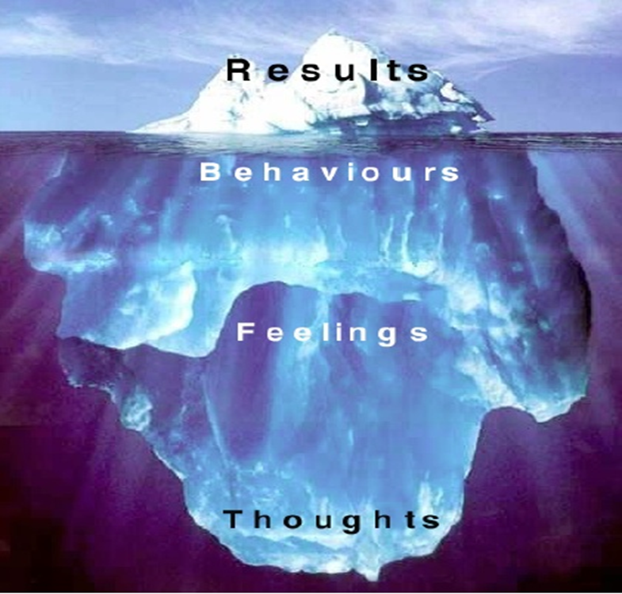
What’s at play?
BEHAVIOUR IS DRIVEN BY YOUR THINKING

Slide 7
What’s at play?

Slide 8
What’s at play?

Slide 9
IGNORE EMOTIONS AT YOUR PERIL
STATUS
CERTAINTY
AUTONOMY
RELATEDNESS
FAIRNESS
Toward Away From

Slide 10
So what’s important as the facilitator?
Before the event:
Be aware of your own hardwiring and emotional responses
Prepare, prepare, prepare
Create a ‘safe’ environment for people to work together productively – purpose, agenda, ground rules
During the event:
Build trust with the group – no trust, no influence!
Stay ‘tuned in’ – be present at all times and remember SCARF
Manage your own emotional response - remember that everyone’s behaviour makes sense to them
Deal with ‘tricky’ behaviour with respect, but deal with it!
Use great listening, clarifying and reframing skills

Slide 11
TRAC
T = Thanks
R = Restate (clarify)
A = Answer
C = Confirm

Slide 12
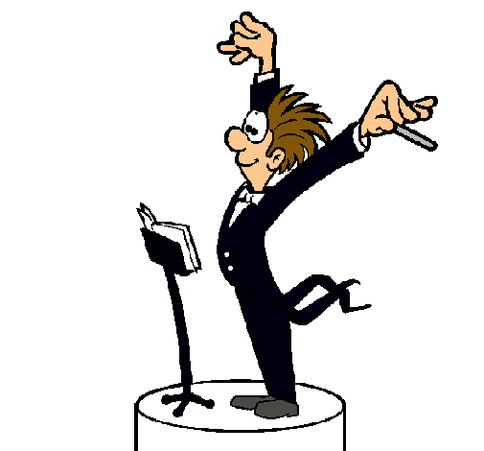
Potential ‘tricky’ behaviours & tactics
Passive aggression – ‘sniping’
Sympathy seeking – victim mentality
Competing – ‘bulldozer’
Seeking approval/recognition
Negative humour
Withdrawing/lack of engagement
Over enthusiasm!

Slide 13
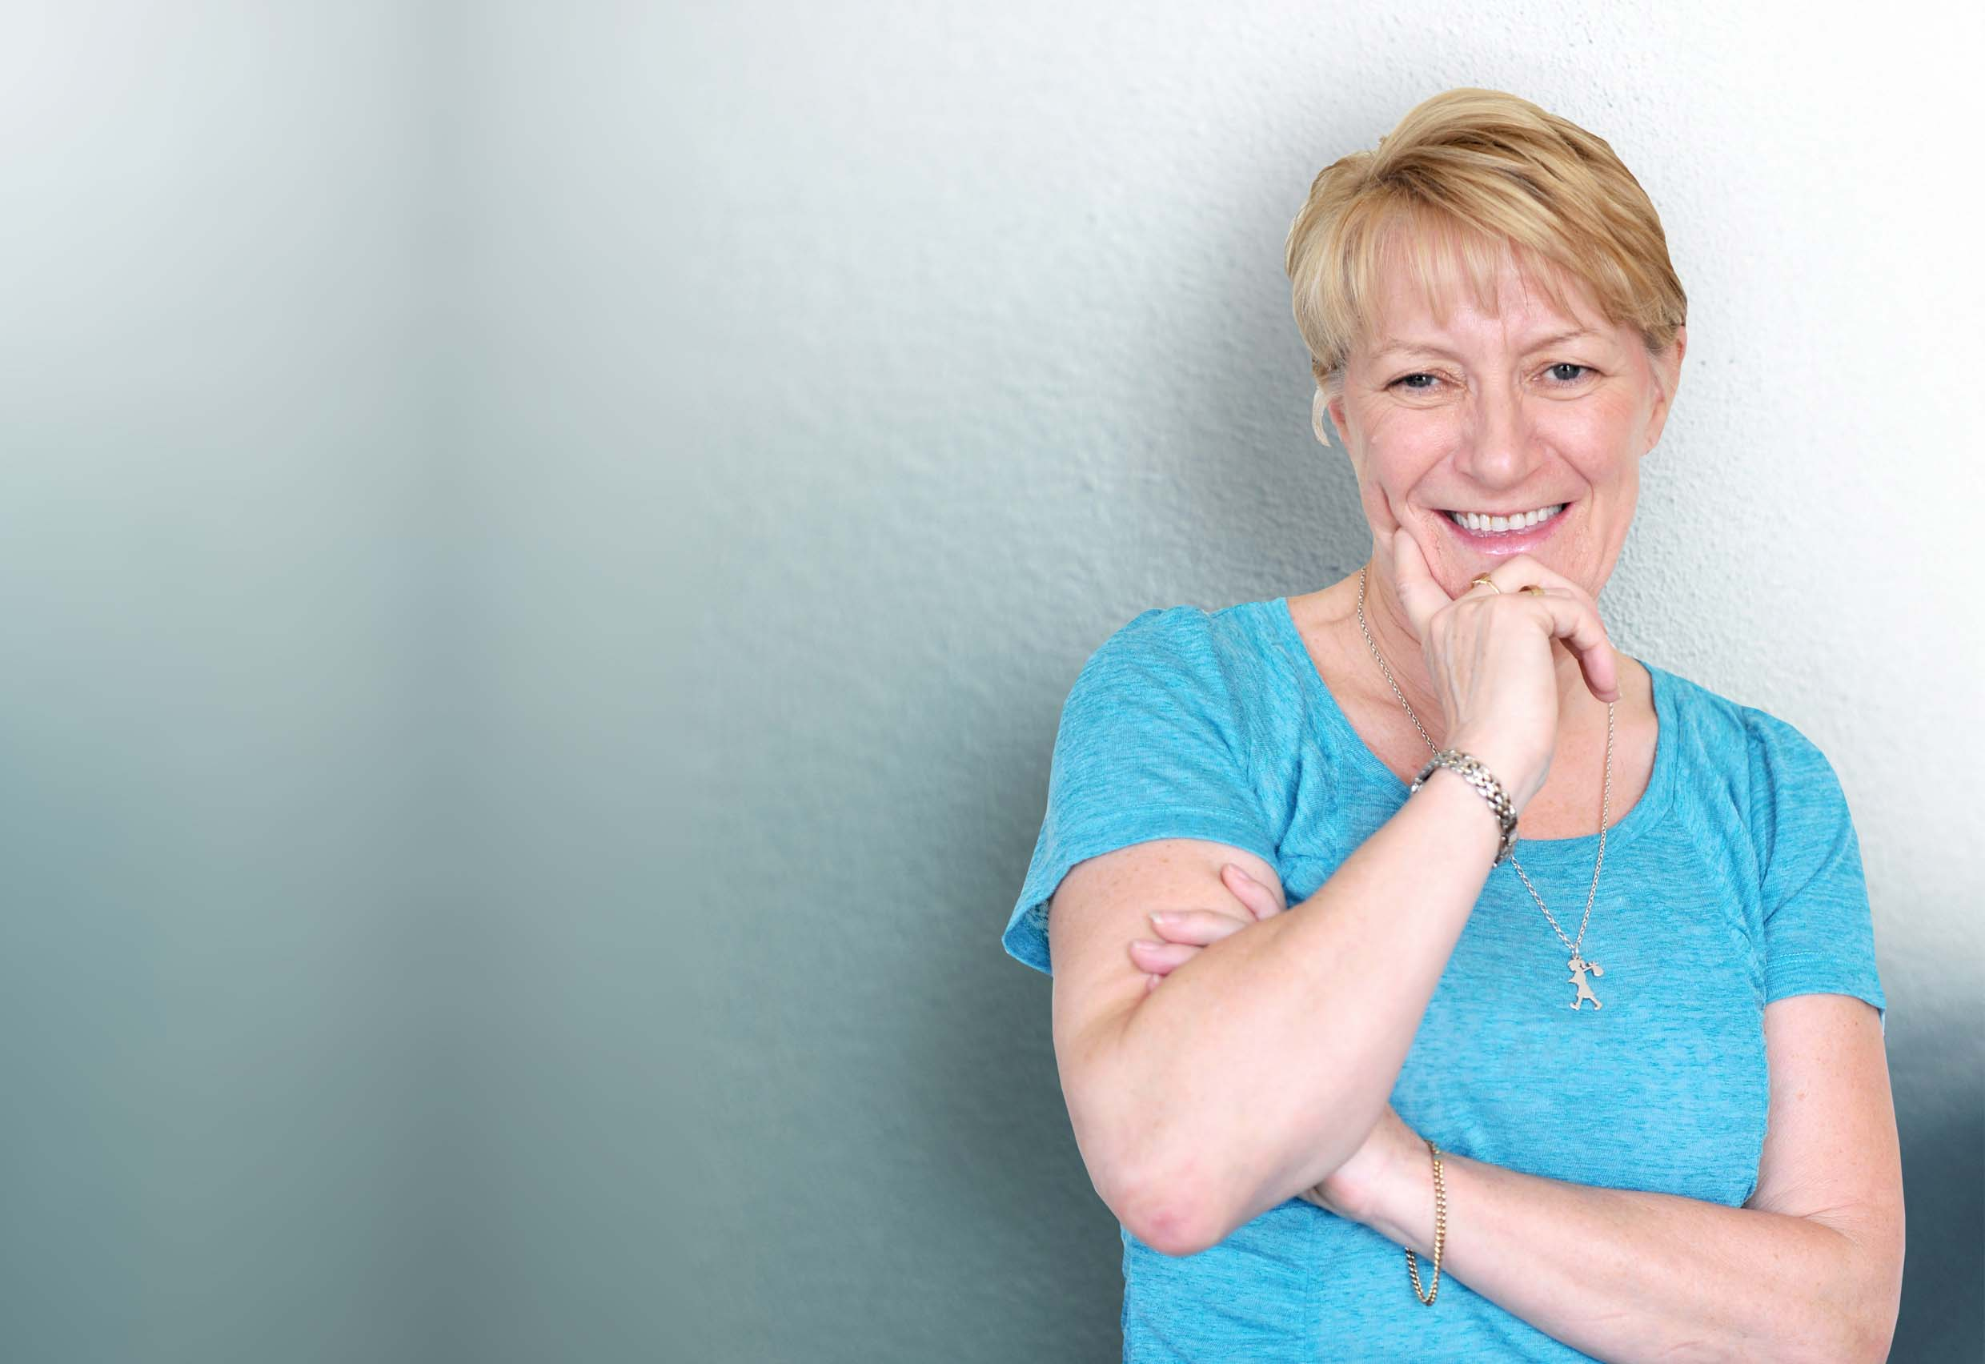
Denise Carter | Director +64 21 833 841 +64 9 524 7228 Email: denise@mantle.co.nz

