Slide 1
Action Mapping for rapid elearning development
Action mapping
for rapid elearning development
Miranda Verswijvelen
Senior Instructional Designer

Slide 2
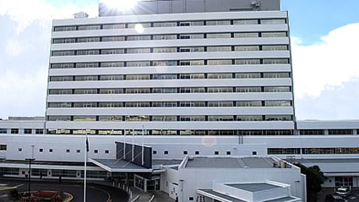
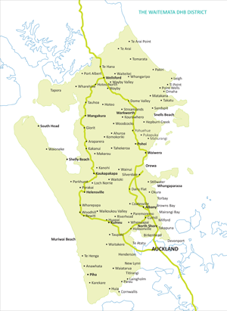
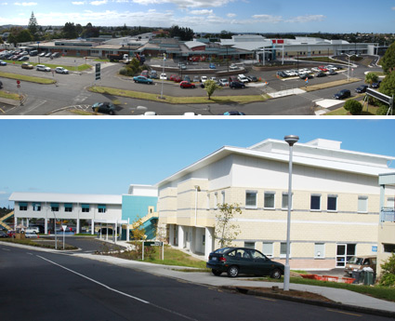
Largest NZ DHB by population: 580,000 people
Employs more than 7000 people
Learning Technologies team of 3 FTE – growing to 4!

Slide 3
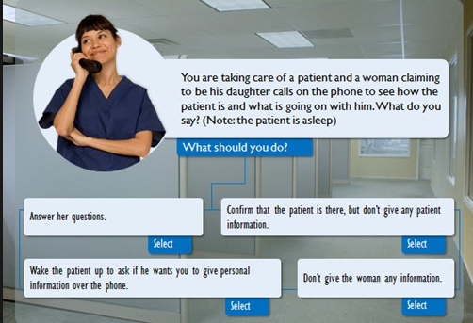
i
i
i
i
QUIZ

Slide 4
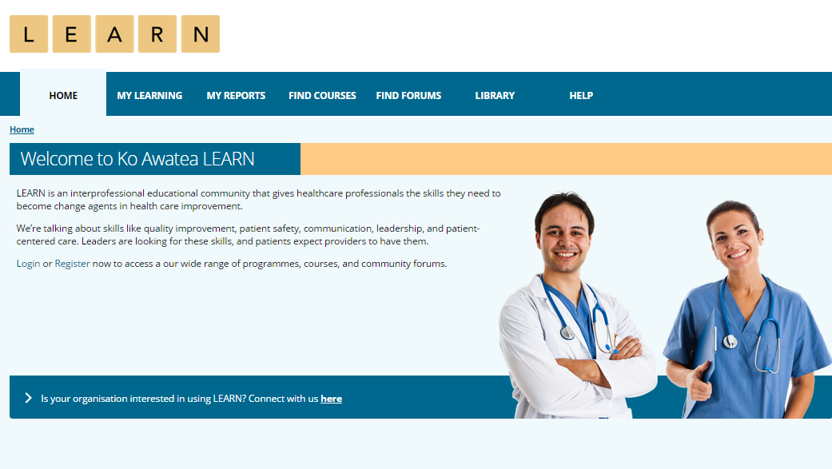
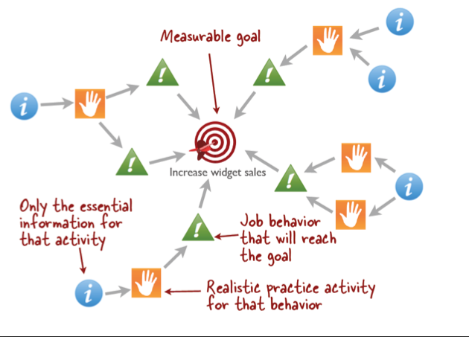

Slide 5
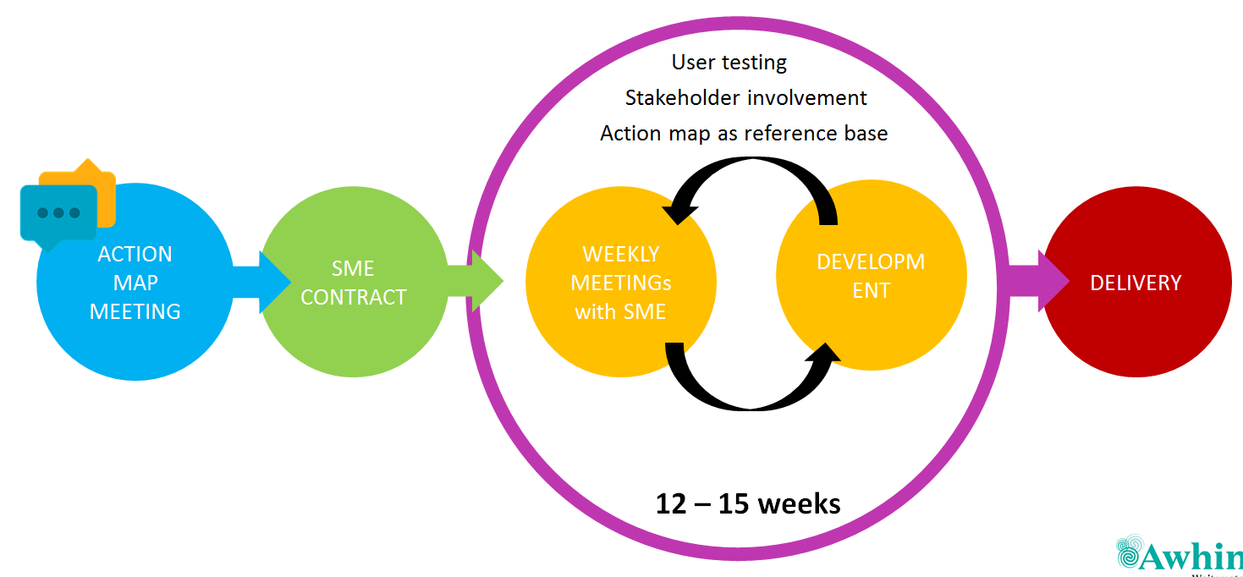
Agile development

Slide 6
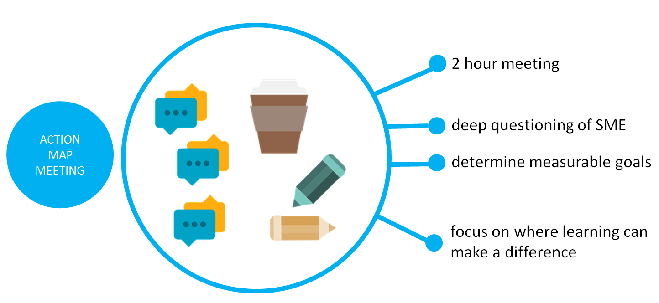

Slide 7
Cathy Moore
i
i
(Job) behaviour that will help achieve the goal
!
!
i
Realistic activity to practice the behaviour
Essential information for the activity
A measurable goal
!
!
i
i

Slide 8
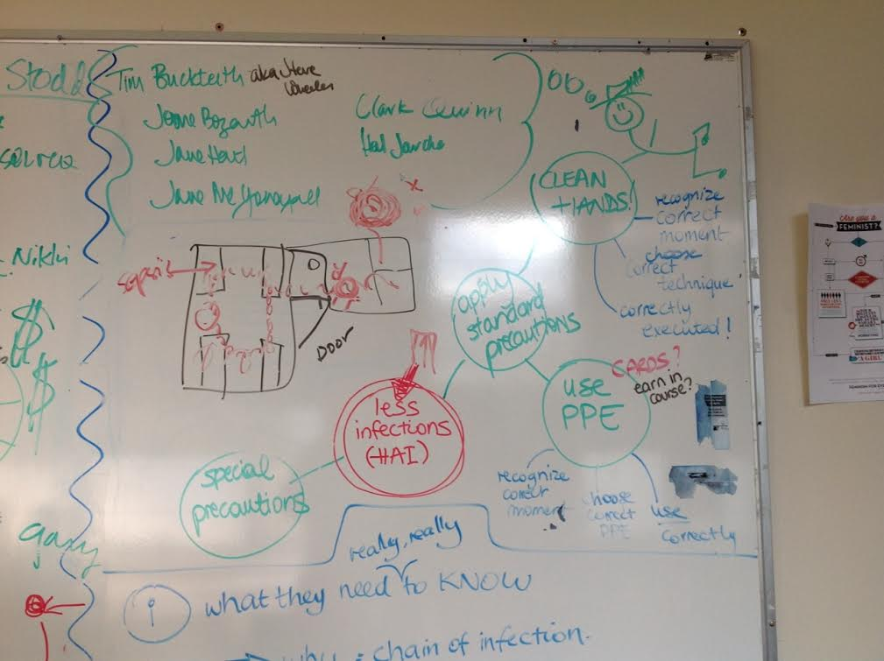
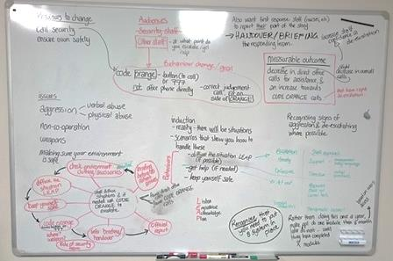
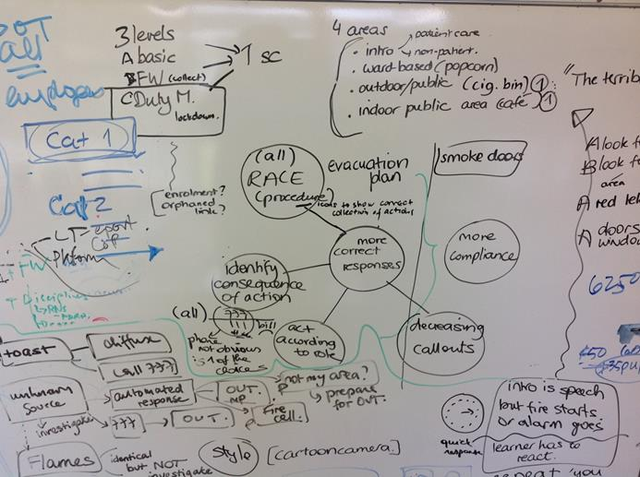

Slide 9
Apply IPCC precautions and techniques when required
Recognize the moments for precautions
Choose the correct precaution technique for the moment
Execute the precaution technique correctly
Increased use of correct PPE at the correct moment
Decrease HAI across the organisation (through non-compliance)
Increased compliance with all required IPCC precautions and techniques

Slide 10
Agile development

Slide 11
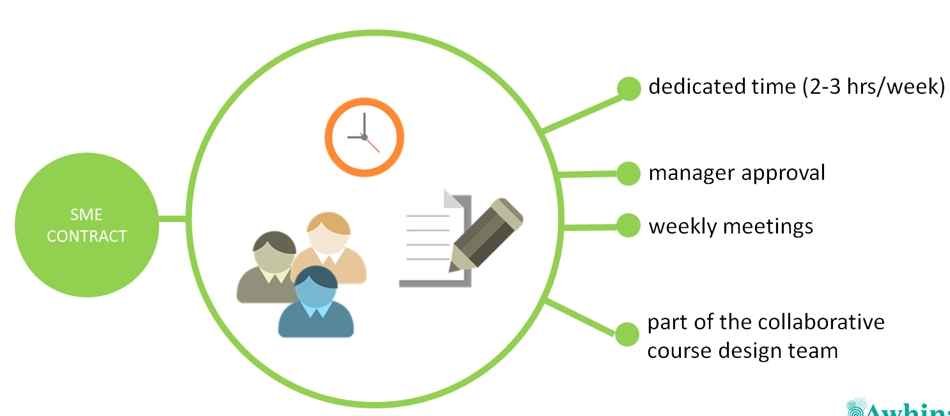

Slide 12
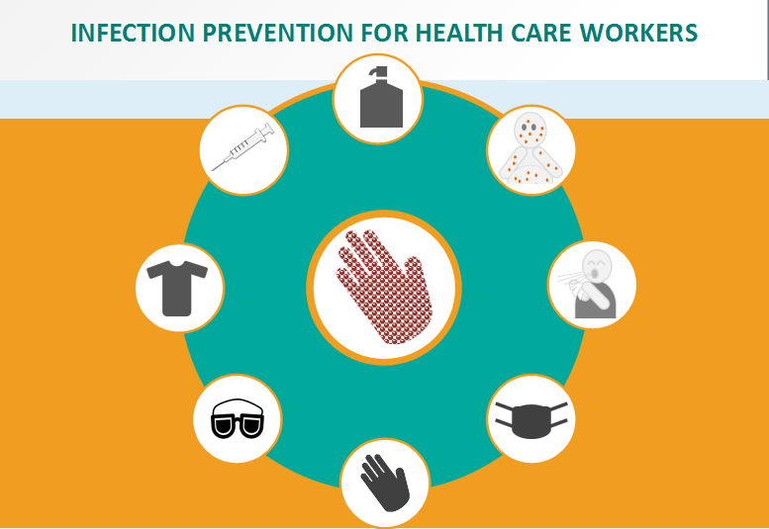
So what does this action mapping look like in a module?
Notes:
We will now give you example.
From the board to one of the final screens.
Hand hygiene. How can we make them do it? Practice it? It is an integral part of each act. So that’s what we did.

Slide 13
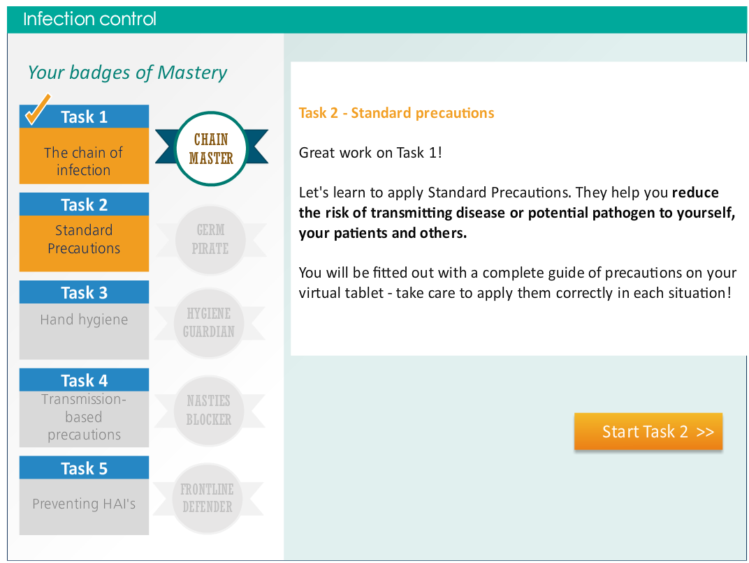
Gamified learning design chosen to emphasize
the areas of action identified to achieve the big goal.

Slide 14
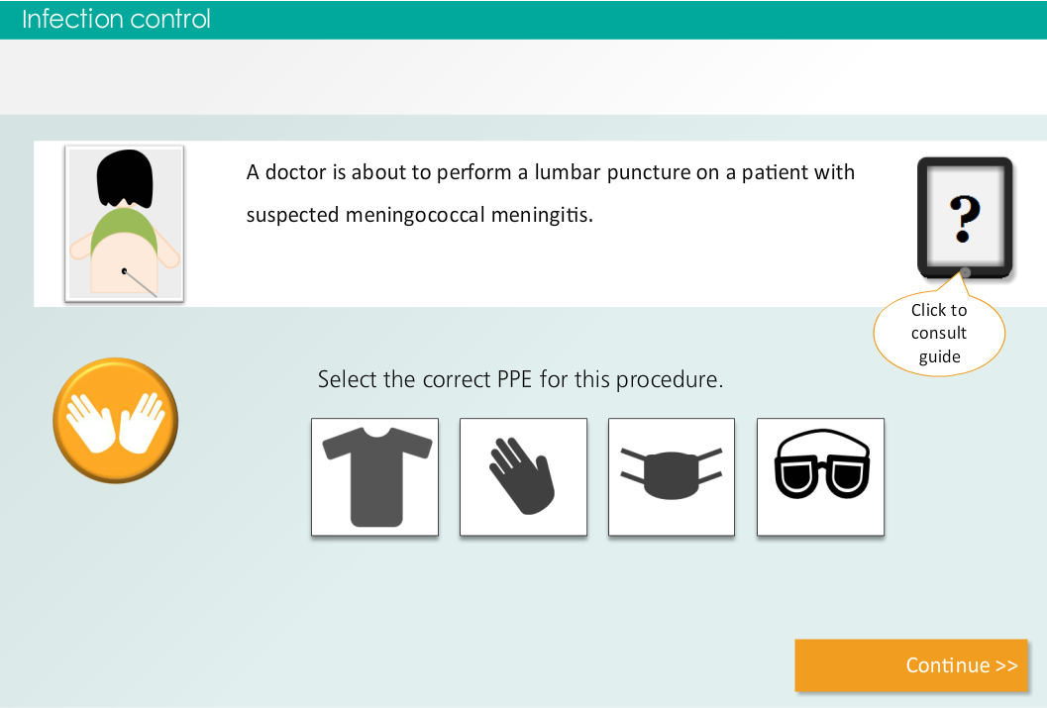
The hand hygiene issue – it needs to happen without thinking.
Notes:
Big challenge to sole: hand hygiene.
Multichoice question – should you now wash you hands, does not cut it.
It’s an integral part of what you do, it should be routine – happen without thinking.
So how did we emulate that?
This is a mini-scenario in the module. The actual question is about PPE.
But watch what happens…

Slide 15
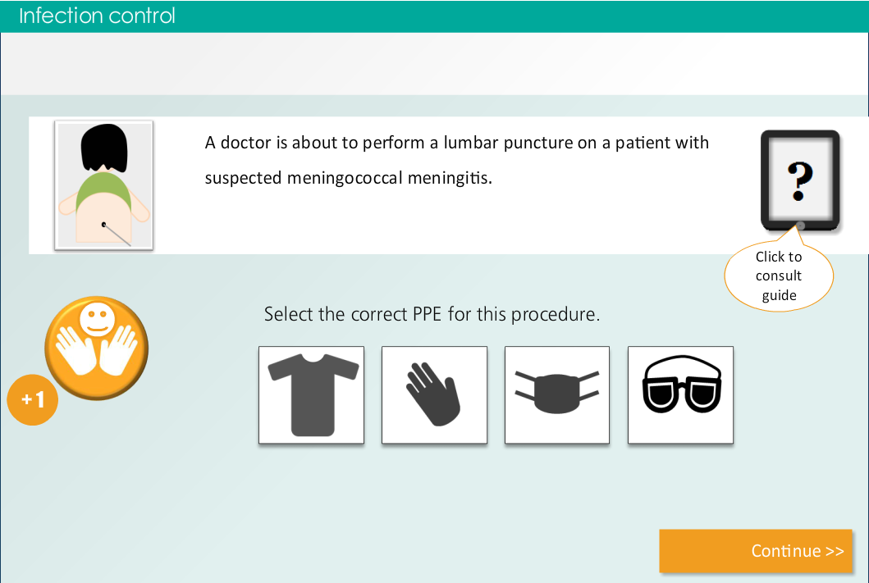

Slide 19
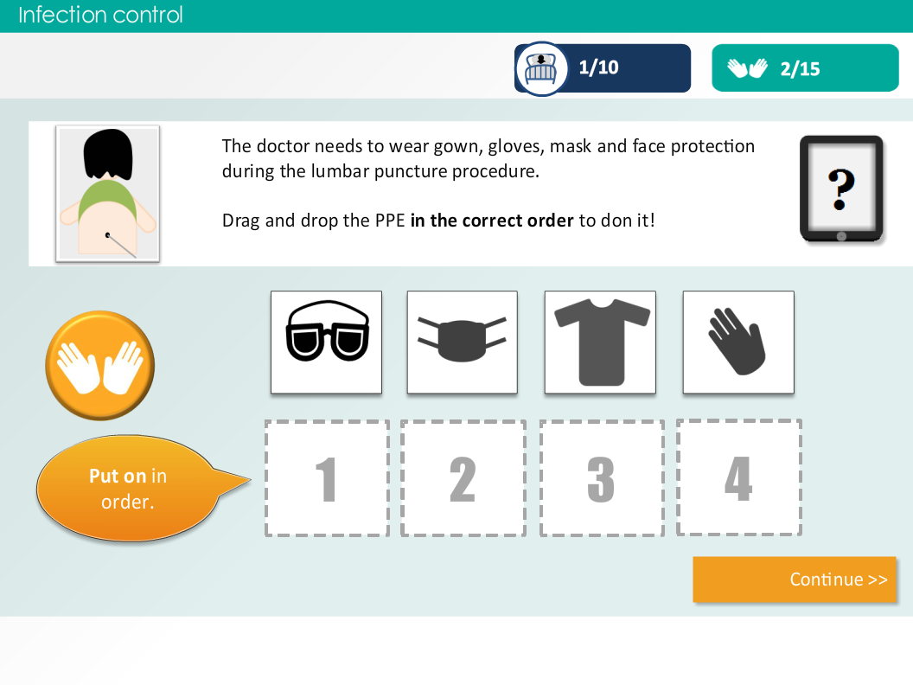
Notes:
This next questions continues on from the scenario.
You’ve chose the correct ppe, now put it on in the right order.
Oh, and don’t’ forget to wash your hands to get your points!!!!

Slide 20
Agile development

Slide 21
WEEKLY MEETINGs with SME
DEVELOP
12 – 15 weeks
Close collaboration with SME – they are part of the team
User testing at different stages
Regular check in with governance teams and management
If in doubt… always return to the action map.
Notes:
The action map helps you to make the scenes focused on your goal.
If you seems to have some convoluted discussion, return to the goals.
If your SME starts to go overboard with content, return the the action map. Does it serve the goal of this particular coursecourse? No, then leave it.
Example of sonya this morning?
They need to do this GCS test because of the patients situation.
But giving them a full explanation of how the test works?
No we throw that out, because it is not the purpose of this course to learn that.

Slide 22
So how does the agile development work exactly?
Notes:
A live example of the development cycle.
This won a platinum LearnX award…

Slide 23
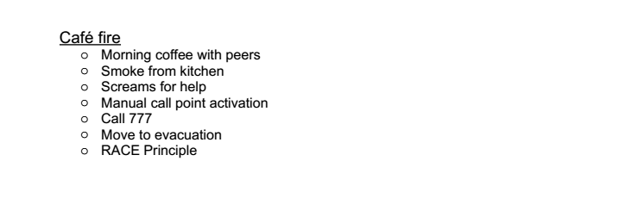
Basic SME scenario provided
Part of weekly ‘SME homework’
No writing or content dump up front

Slide 24
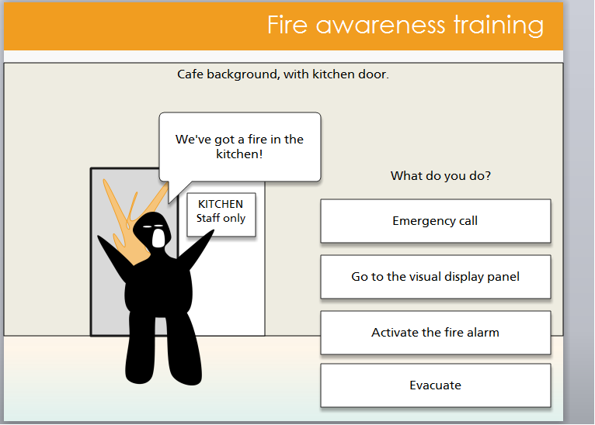
No storyboard – rough shapes and flows in Storyline to start
Accompanied walkthrough and online access to every version
Discussion – collaboration on scenario development
Quick changes on spot: add text bubbles for notes, change words

Slide 25
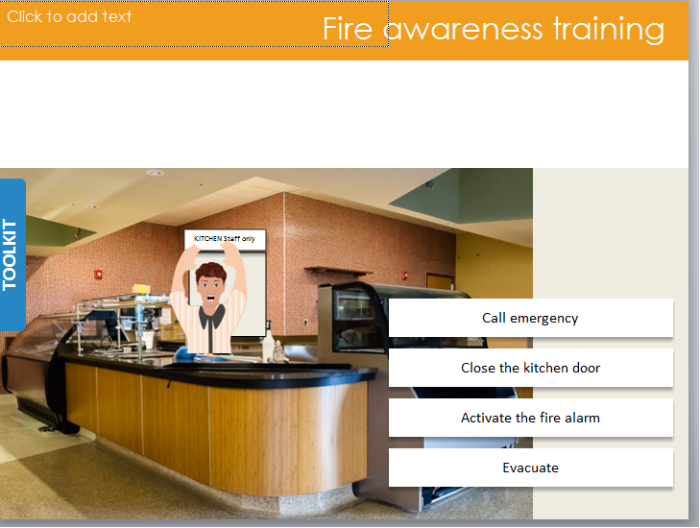
Screens change every week
Graphic design ideas take shape
SME’s provide graphics where necessary
Scenarios can still change on user feedback

Slide 26
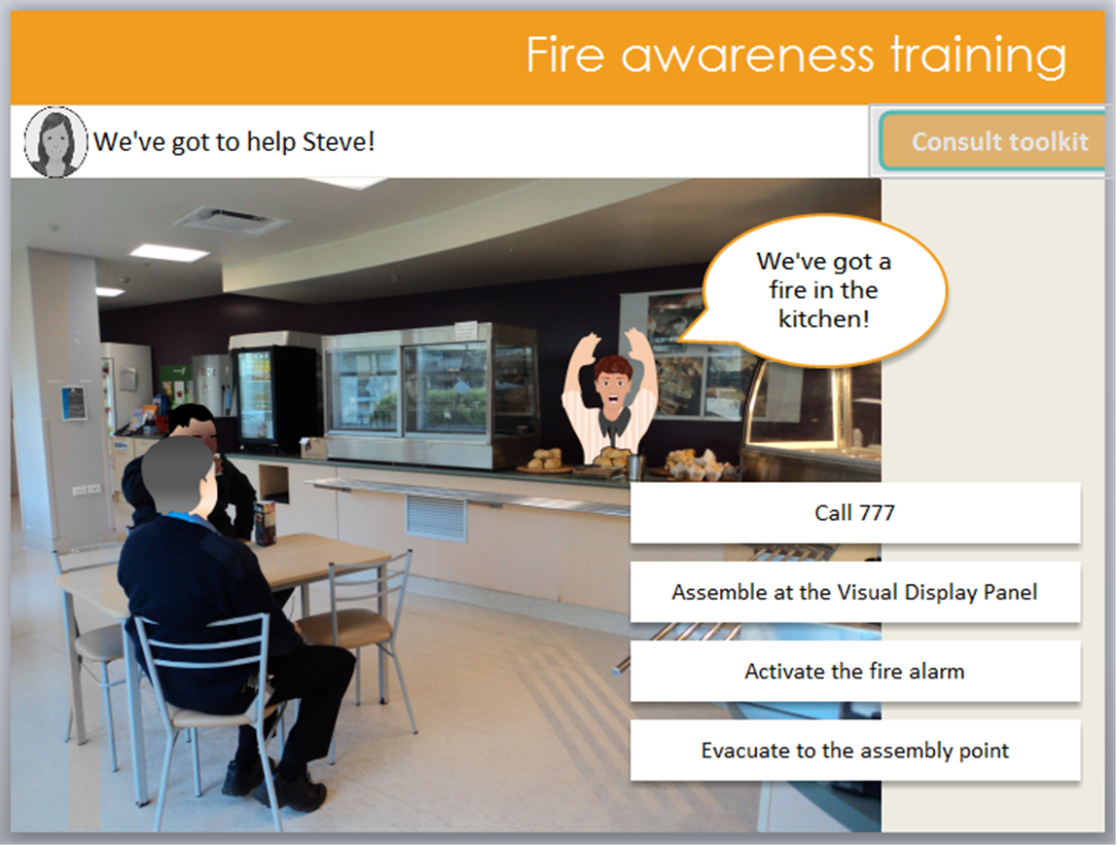
Delivery date in view!
Collective excitement
Work on screen consistency. Heavy use of master slides supports constant change!
80-20 thinking for launch.

Slide 27
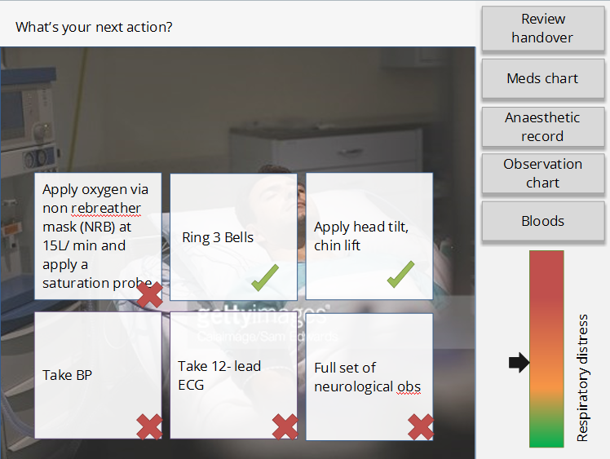
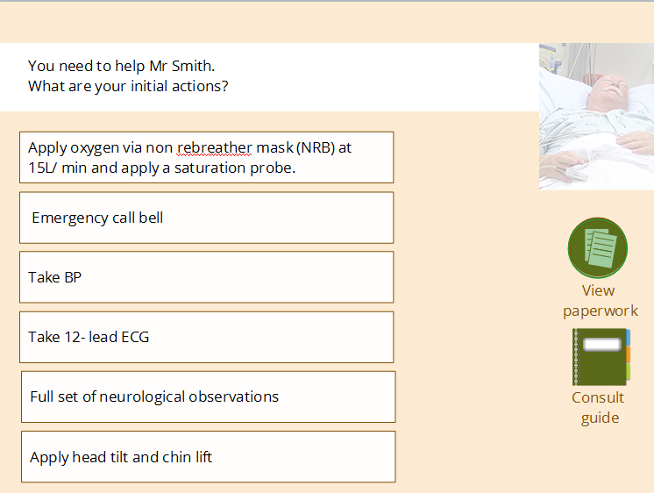
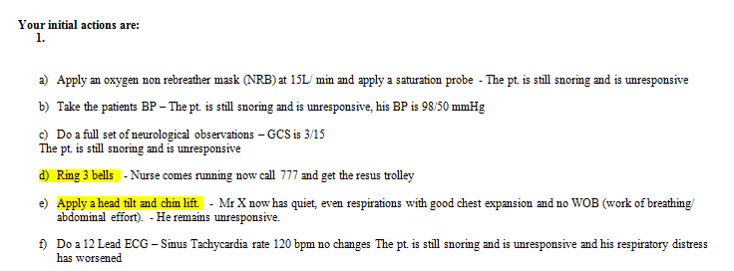
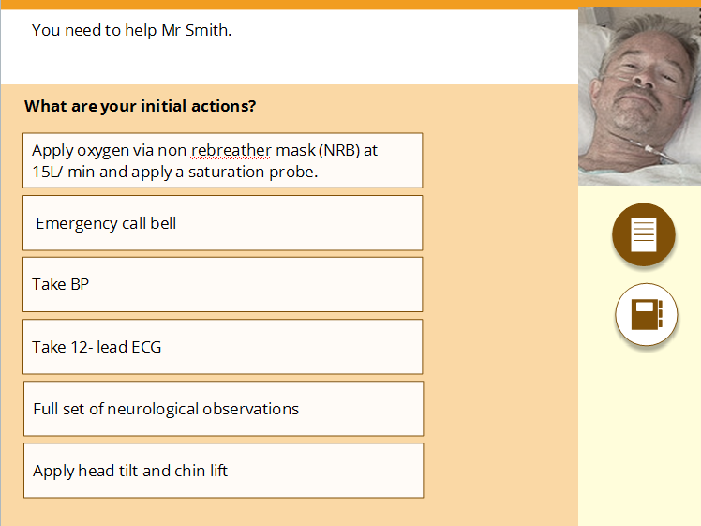
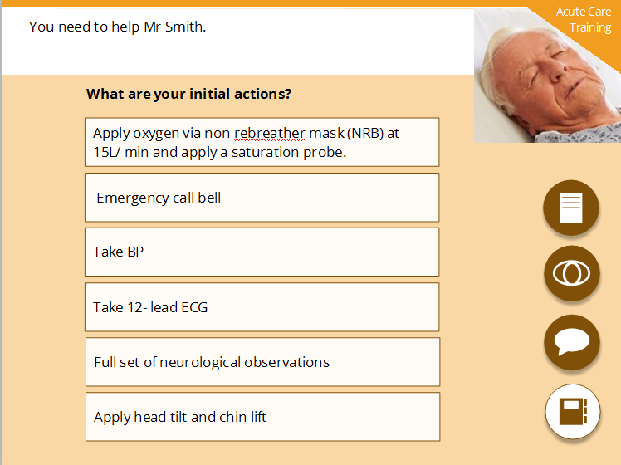
Another quick example: Acute Care Training
Notes:
Another quick example of how a screen changes over time.
From the scenario – too technical…
To the first endeavour of a screen – notice the respiratory distress meter?
It’s gone. It goes into a consequence feedback – if you do too many unnecessary things, Mr Smith goes into cardiac arrest.
The buttons have also gone, and are bundled into a ‘paperwork’ button, that is always available. There is a guide for constant use, and at the end you have a constant ‘talk to patient, observe patient option which gives you insight in what your actions have achieved.
Three bells has changed to emergency call as not applicable for all
Patient pic from quick insert, to a new choice, to a stockphot0o and a pretty layout ☺

Slide 28
Evaluate!
User feedback!

Slide 29
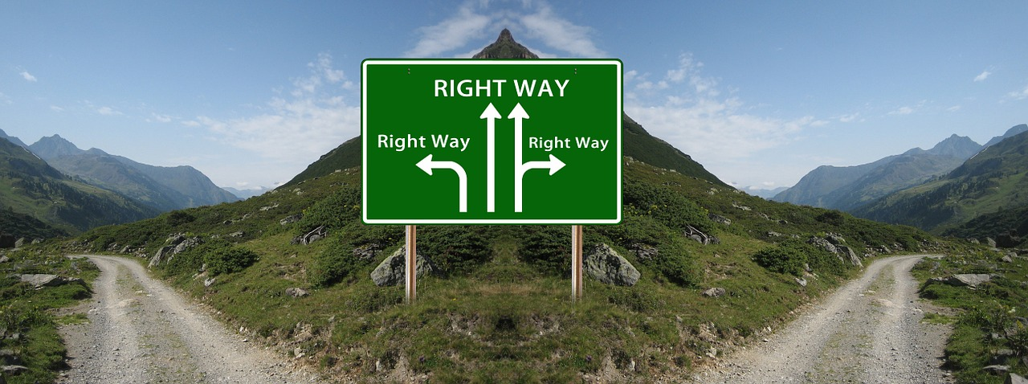
A secret?
Hold decisions lightly!
Don’t be afraid of crazy ideas. Try, test, engage.
Learn, explore other’s work, other media
Notes:
Make sure you understand the difference between ownership and responsibility.
Be proud of your work, but be prepared to throw stop and go back to a fork to choose another road.
Collaboration means being open to positive criticism, learn from your SME, learn from your colleagues. (our collaborative sessions…)

Slide 30
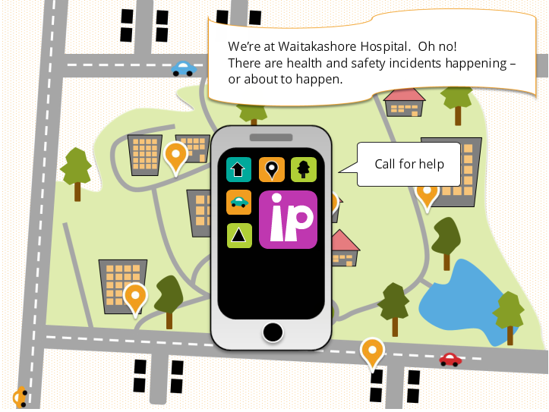
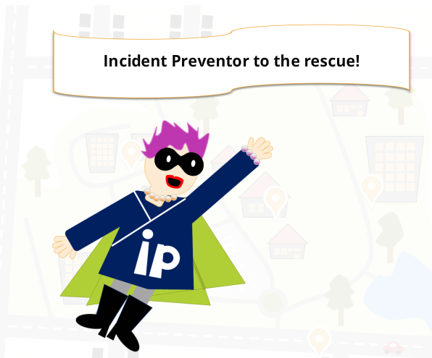
Do our modules work? Do we achieve behaviour change?

Slide 31
What did you like about this course?
it is engaging and easy to understand and remember.
Where to locate incidence forms or who to talk to for more advice
the interaction to get the answers right
made you think about it more
That we could go back if we got a mistake
Virtual experience and illustrations
informative refreshed knowledge of what to do in certain incidents

Slide 32
Some useful links:
The award winning fire course: http://bit.ly/1LO3I9d
Action mapping for elearning – Cathy Moore http://blog.cathy-moore.com/
Building branched scenarios – Tom Kuhlman (Articulate rapid e-learning blog): http://bit.ly/1LO4bYU
Contact me:
miranda.verswijvelen@waitematadhb.govt.nz
https://www.linkedin.com/pub/miranda-verswijvelen/5/bbb/275

