Slide 1
Focussing on the things that matter the most to the business through performance partnering

Slide 2
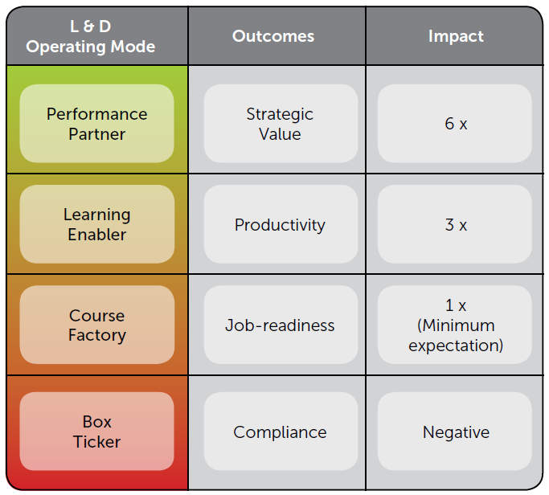
Which mode do you operate your LD service?
Building a High Impact Learning & Development Function White paper July 2017- http://michelleockers.com

Slide 3
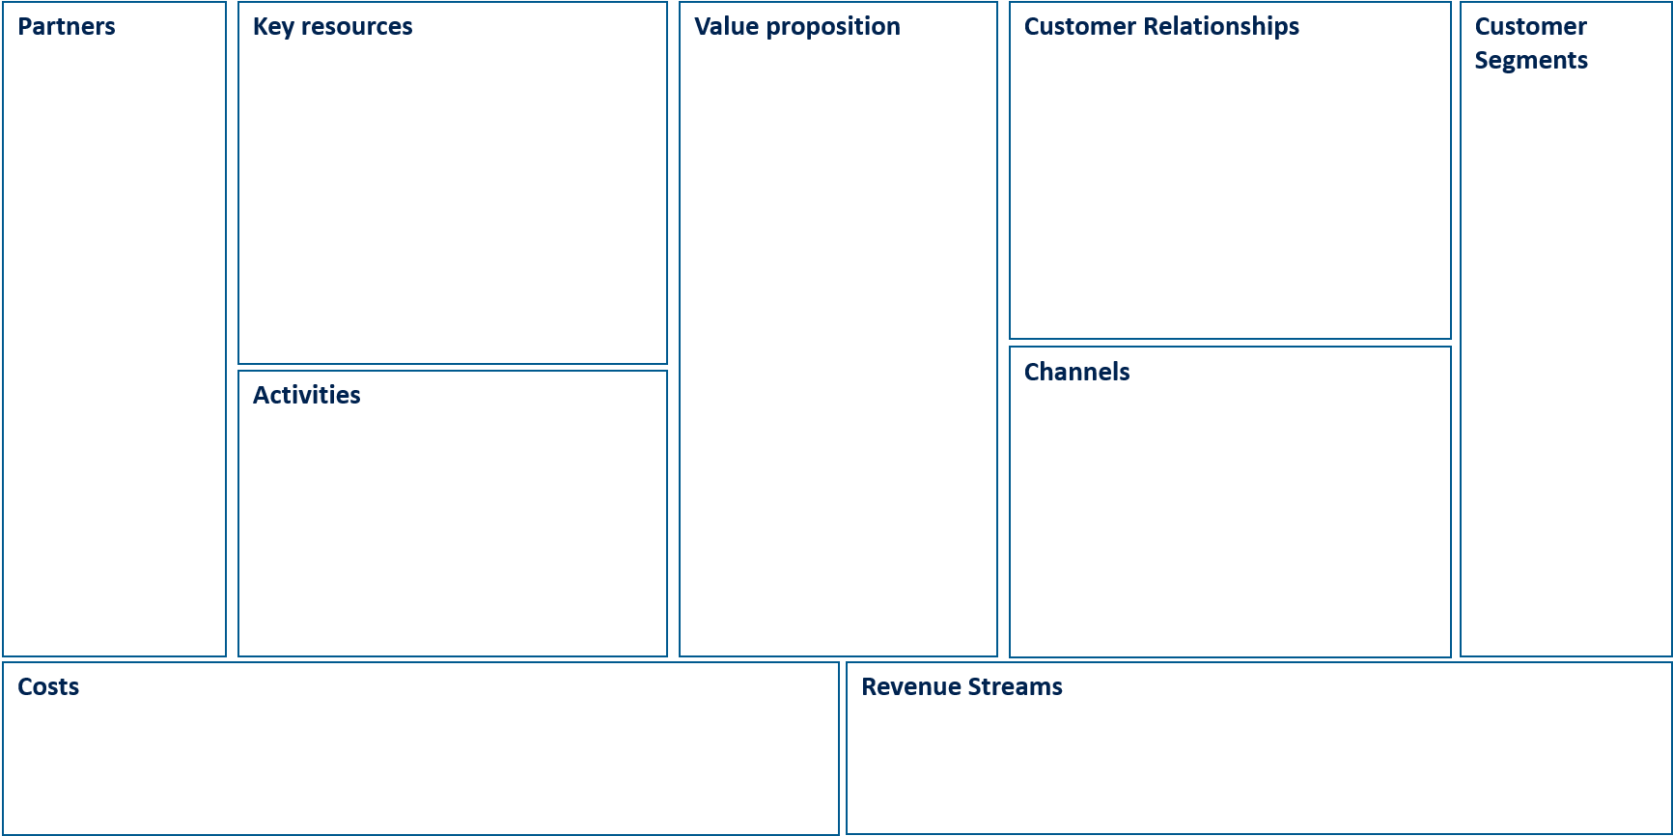
The Business Model Canvas – Current State
Key learning
Complete as a team – collectively your team know more than you!
Encourage bold discussion and debate on the existing operating model i.e. why are we doing that? what is the value for the customer?
There are many components that make up an LD function – how do you know what is missing and what needs to be there?
https://strategyzer.com/

Slide 4
What we came up with
Partners
Key resources
Value proposition
Customer Relationships
Customer Segments
Who we work with externally
Key resources within my team
The difference we make through our work
Key relationships
Divisions we oversee at BNZ
Activities
Channels
Activities key to our success
Various modalities we use to deliver learning
Cost
Revenue Streams
https://strategyzer.com/

Slide 5
Magic and Baggage (current state)
Magic
Baggage
What is the magic that your team do for your customers
Do you have baggage that might be holding you down from delivering great customer experiences?
Customers of Enterprise Learning
What's the magic that happens inside your LD team
What's the baggage you might need to let go of to enable the team to be really successful?
Internal within Enterprise Learning

Slide 6
Therefore…our value proposition is…
Using tech to enable richer conversations
Quicker problem solving
Gain Creators
Gains
Customer Jobs
Customer Jobs
Building commercial astuteness
Speed to insight
Pain Relievers
Pains
Boosting confidence
Mind shift – I’m no longer the expert in this process
https://strategyzer.com/

Slide 7
Notes on people and resources Michelle Ockers - http://michelleockers.com/ Building High Impact LD function Strategyzer – https://strategyzer.com/ Business Canvas Model Value Proposition Model Agile and L&D – https://medium.com/agile-in-learning/tagged/learning-and-development

